Slide 1
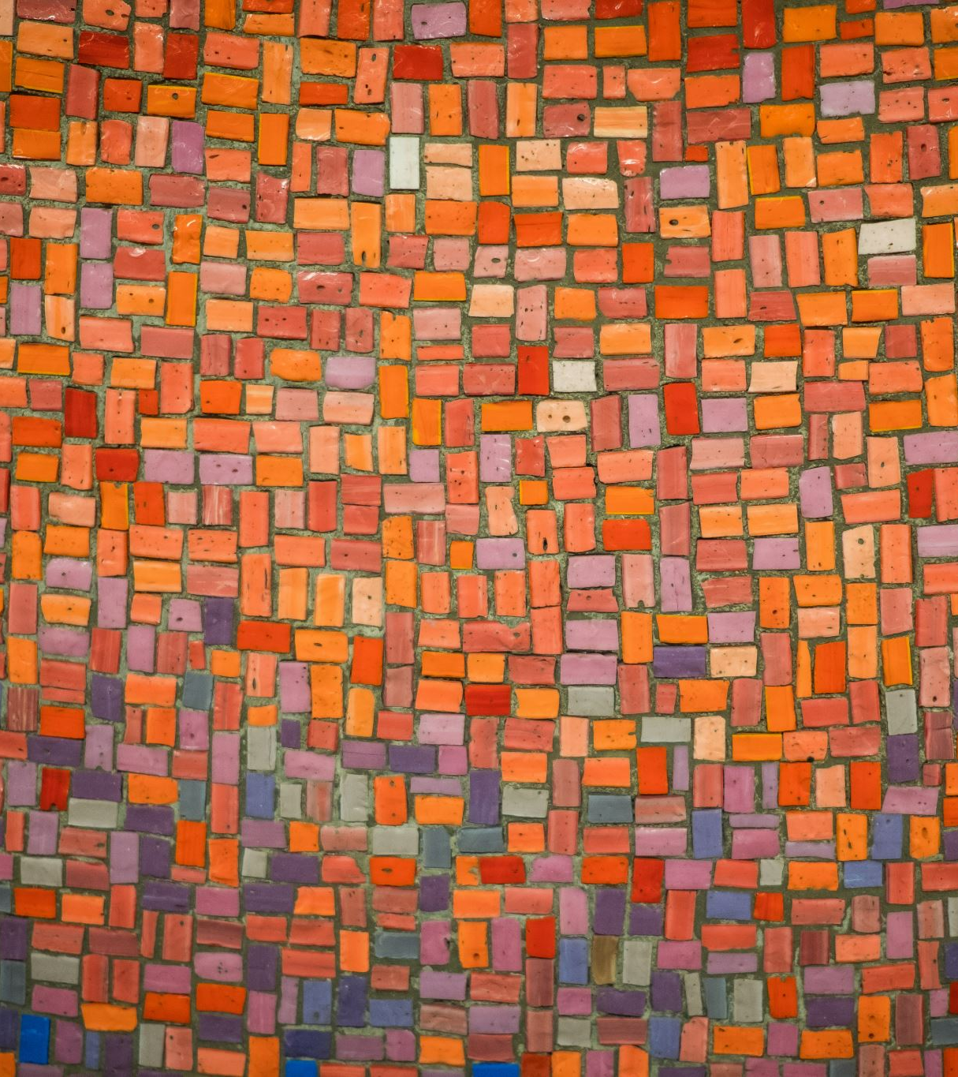
THE OPTIMAL DIET PLAN

Slide 2

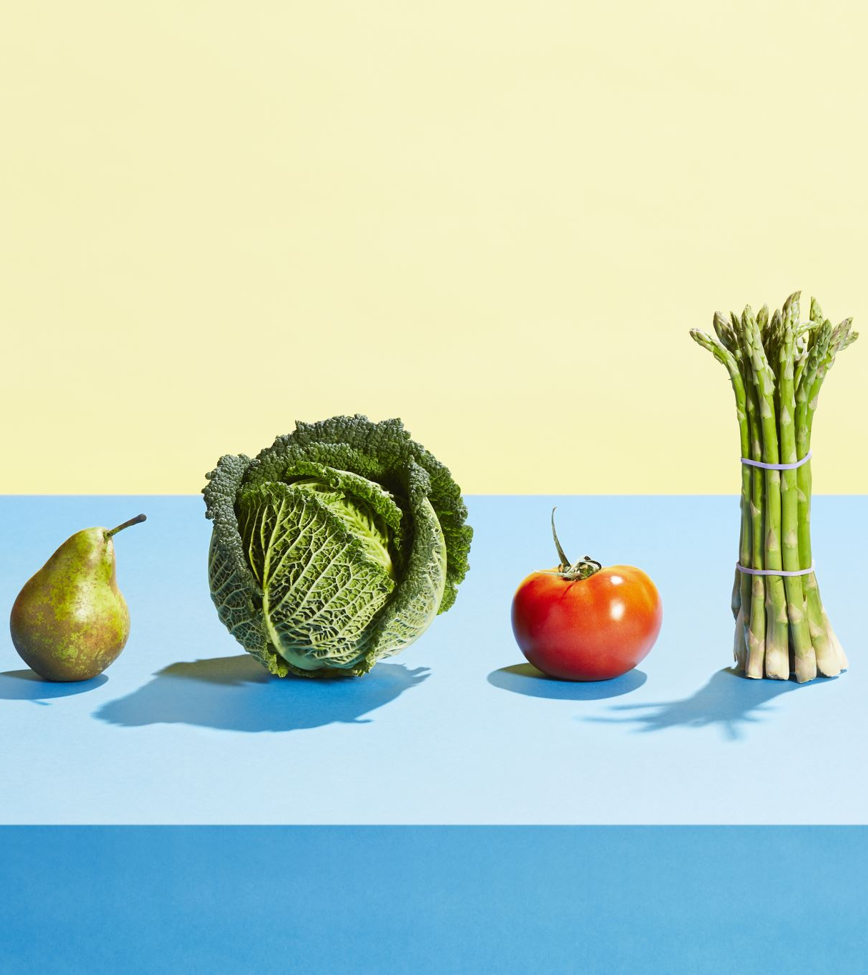
THE OPTIMAL DIET PLAN
Aims to built optimal diet plan
Types of plans : Paleo diet, Vegan Diet, weight loss, Muscle gain
Wholesome meal: considers all necessary nutrients for a balanced diet
Used dietary reference by USDA

Slide 3
Methodology
Used Linear Programming
SOFTWARE : In excel solver and GAMS
ARENA

Slide 4
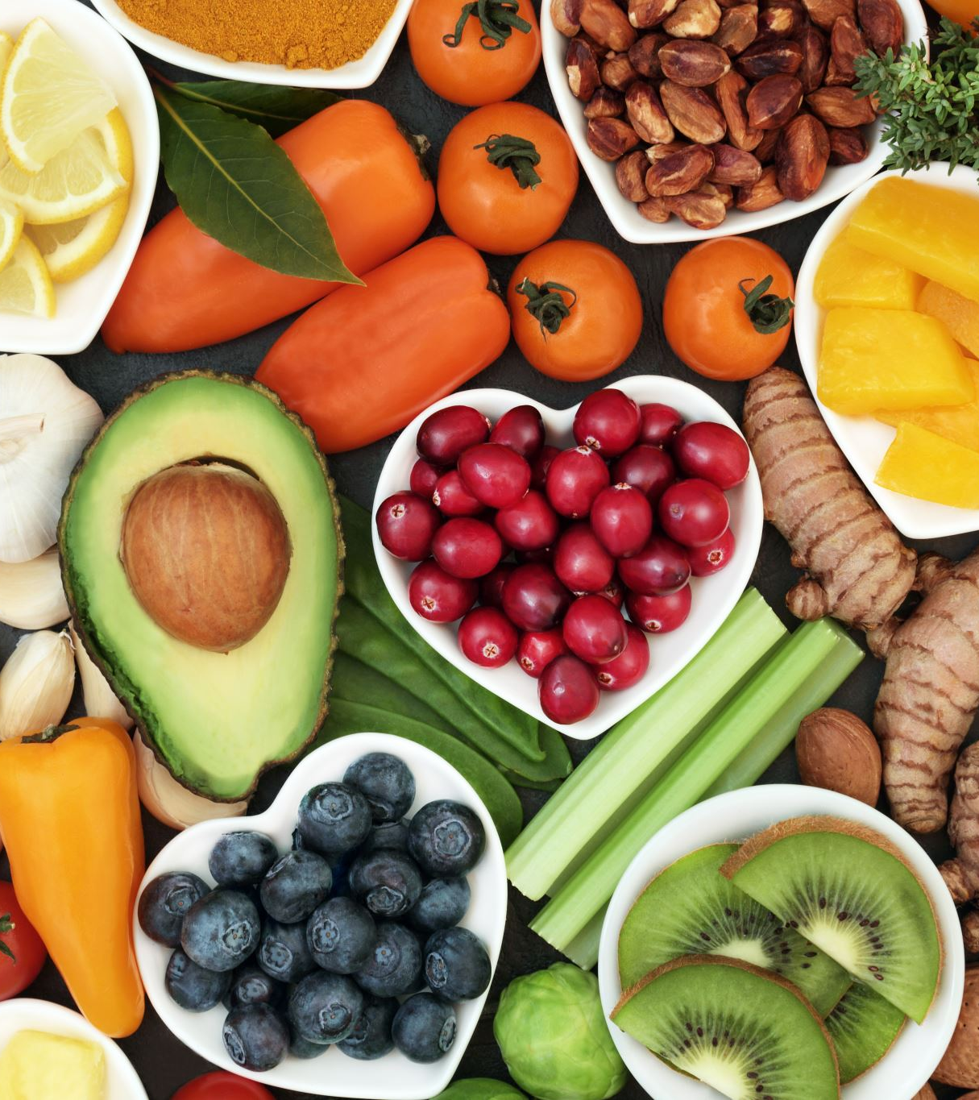
OBJECTIVE
VEGAN DIET : To increase protein and vitamin B12
PALEO DIET : To increase Calcium
MUSCLE GAIN : increase the calorie intake
FAT LOSS : decrease the calorie intake

Slide 5
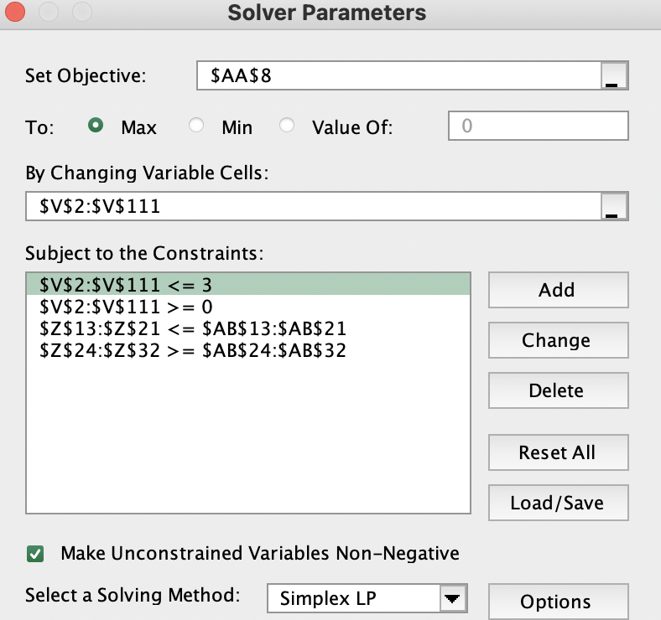
CONSTRAINTS

Slide 6
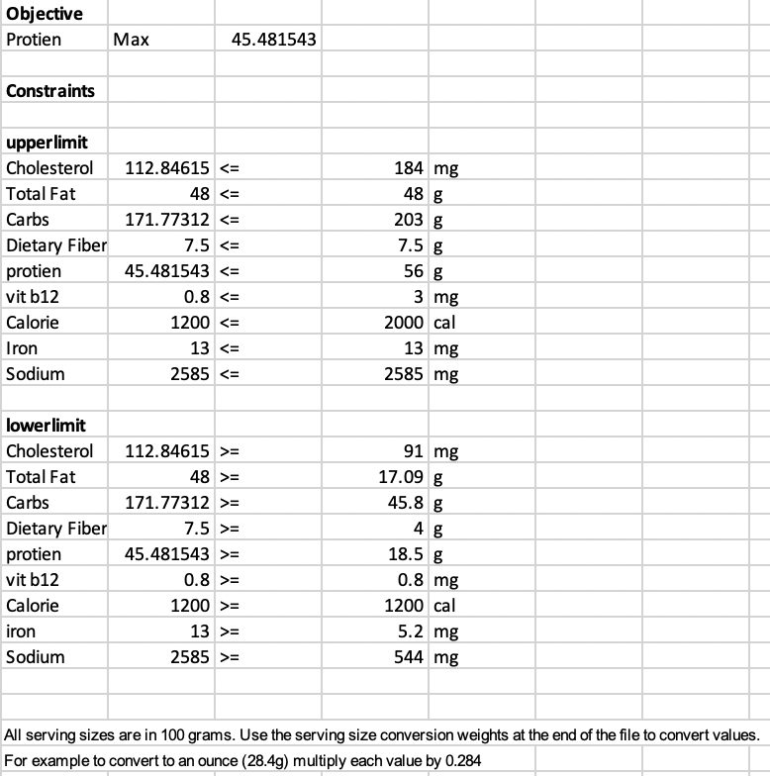
CONSTRAINTS –VEGAN DIET

Slide 7
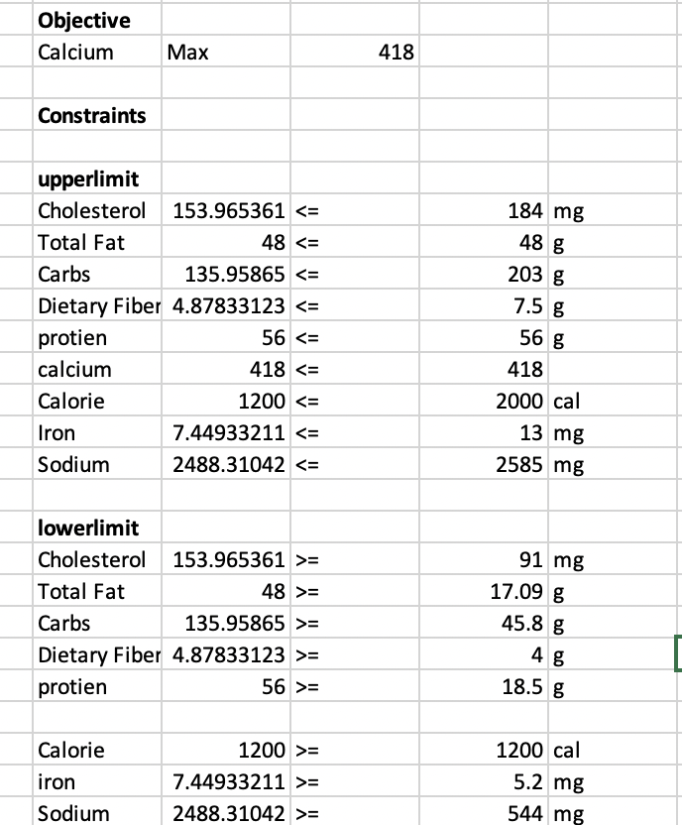
CONSTRAINTS – PALEO DIET

Slide 8
ARENA SIMULATION
Serve 3 meals for 100 patients in one hour period.
20% Paleo diet
40% Weight Loss diet
25% Vegan diet
15% Muscle Gain diet

